Slide 1
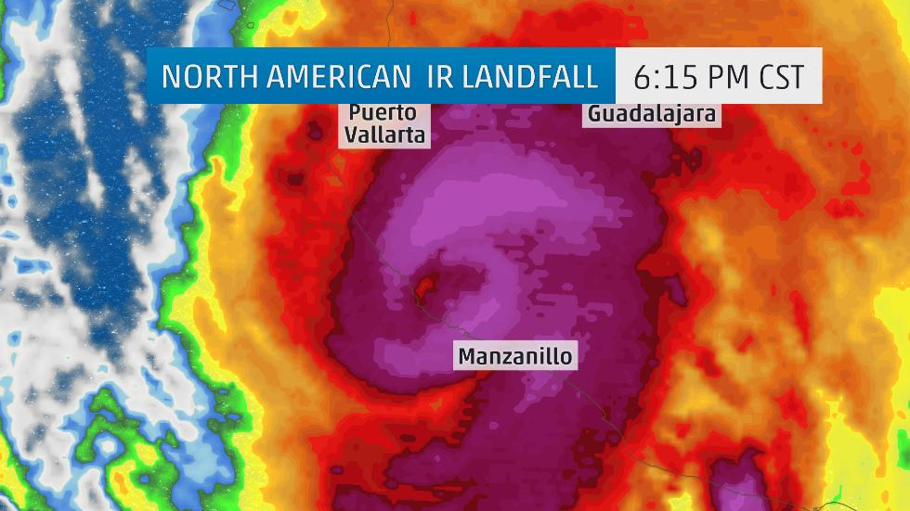
Hurricane Patricia!

Slide 2
Category 5
Hurricane Patricia was a tropical cyclone that formed in the eastern Pacific and rapidly intensified into a Category 5 hurricane. Even more quickly than the storm strengthened, it rapidly weakened over the rugged terrain of Mexico.
On Oct. 23, Patricia became the most powerful tropical cyclone ever measured in the Western Hemisphere as its maximum sustained winds reached an unprecedented 200 mph (320 kph) and its central pressure fell to 879 millibars (25.96 inches of mercury).

Slide 3
New Record!
In addition to its unprecedented 200-mph (320-kph) sustained winds, Hurricane Patricia broke the record for lowest pressure in any hurricane on record. With a minimum central pressure of 880 millibars (25.99 inches of mercury) at the 4 a.m. CDT advisory Oct. 23, Patricia broke the record of 882 millibars set by Wilma in the Atlantic Basin almost exactly 10 years earlier. Around 1 p.m. CDT Oct. 23, the minimum central pressure reached its lowest point, 879 millibars (25.96 inches of mercury).

Slide 4
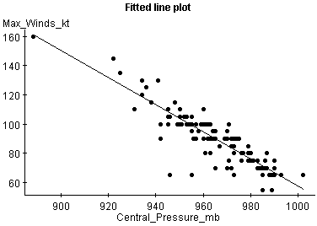
Least Squares Regression Line

Slide 5
when central pressure = 879 mb
Predicted wind speed = 985.15-.93(879) =
167.68 kts or 192.8 mph

